Slide 1
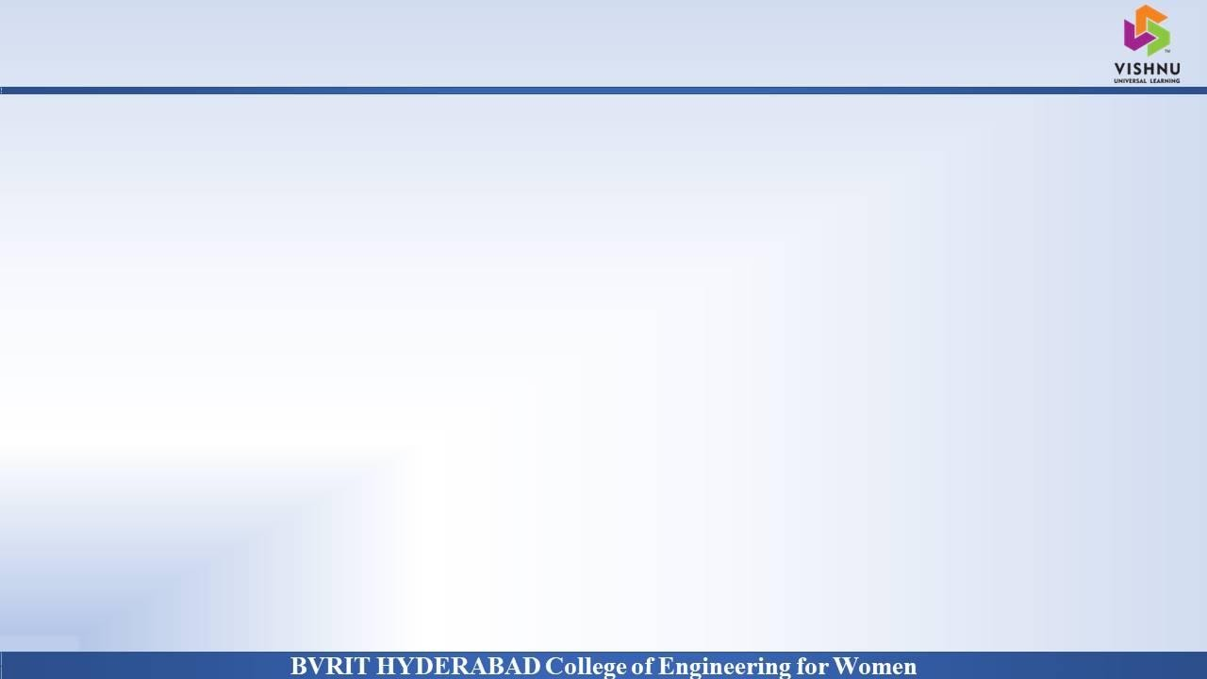
Department of Computer Science and Engineering
TEXT SUMMARIZATION METHOD
Date: 27 May 2021
S.VARSHA : 17WH1A0512
K.PRASEEDA: 17WH1A0533
D.KEERTHANA:17WH1A0555
Internal Guide : Mr . K .Rajesh
Designation: Assistant Professor

Slide 2


Abstract
Why Should I Study this course?
Examples
BVRIT HYDERABAD College of Engineering for Women
In this new era, where tremendous information is available on the internet, it is most important to provide the improved mechanism to extract the information quickly and most efficiently . It is very difficult for human beings to manually extract the summary of a large documents of text .Text summarization has become very essential to gain just the right amount of information from huge texts. Mostly, the methods described and discuss in this is produce Abstractive (ABS) or Extractive (EXT) summaries of text documents and about the structured based and semantic based approaches for summarization of the text documents.

Slide 3
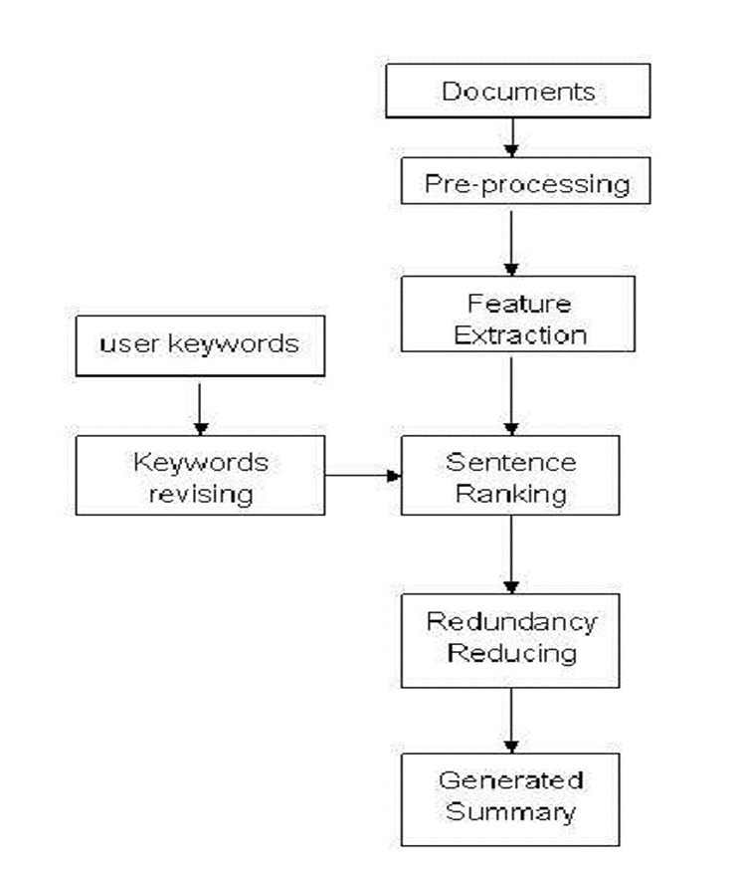
Architecture
Why Should I Study this course?
Examples
BVRIT HYDERABAD College of Engineering for Women

Slide 4
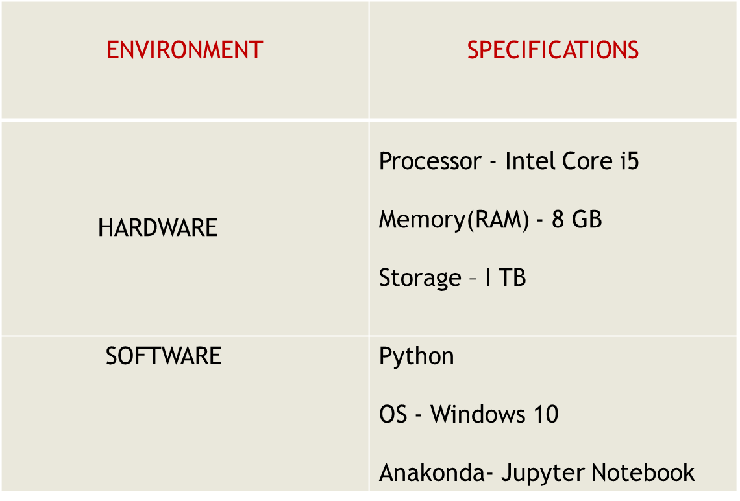
System Requirements
Why Should I Study this course?
Examples
BVRIT HYDERABAD College of Engineering for Women
, PyCharm

Slide 5
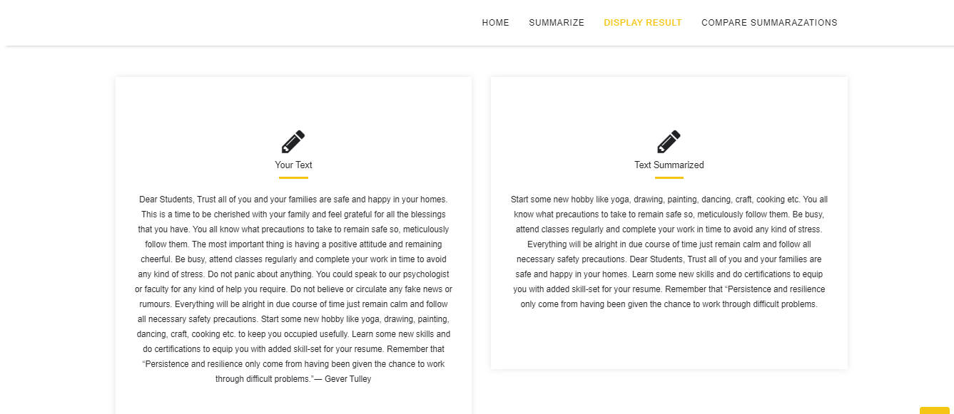
Why Should I Study this course?
Examples
BVRIT HYDERABAD College of Engineering for Women

Slide 6

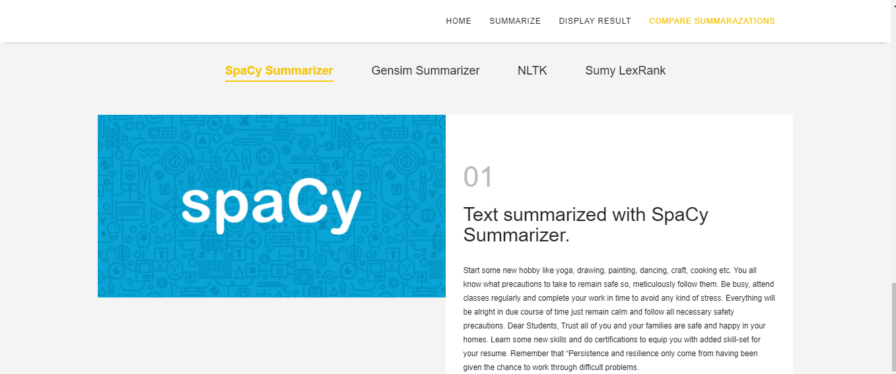
Why Should I Study this course?
Examples
BVRIT HYDERABAD College of Engineering for Women

Slide 7
Thank you

